Slide 1
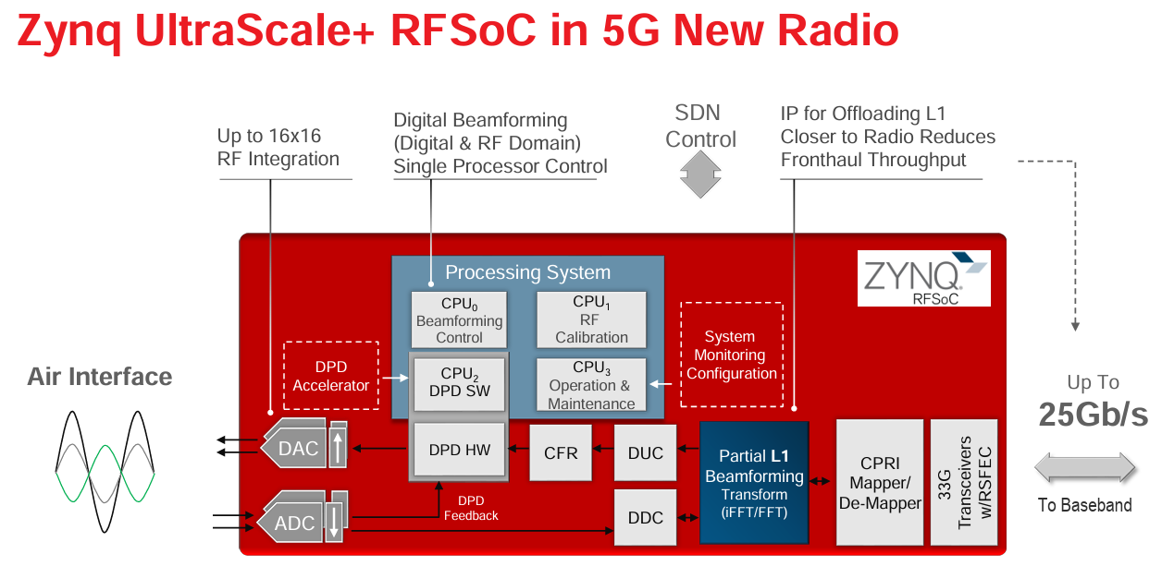
“Modern” Digital Processing Systems :
AMD/Xilinx RFSoC type 1

Slide 2
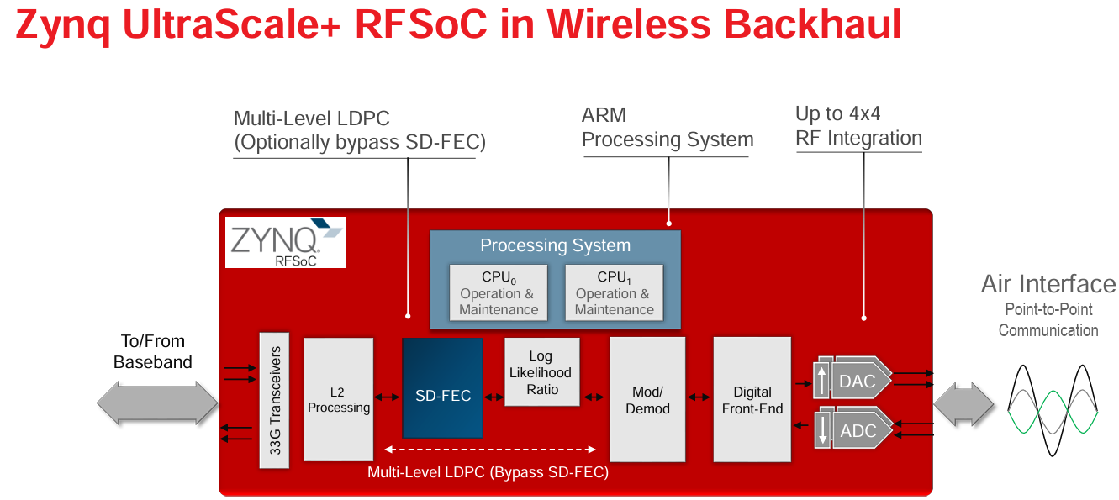
“Modern” Digital Processing Systems :
AMD/Xilinx RFSoC type 2

Slide 3
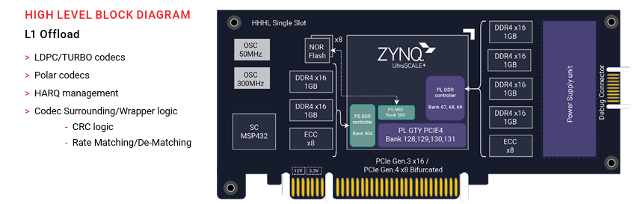
“Modern” Digital Processing Systems :
AMD/Xilinx RFSoC type 3 (HW Accelerator)

Slide 4
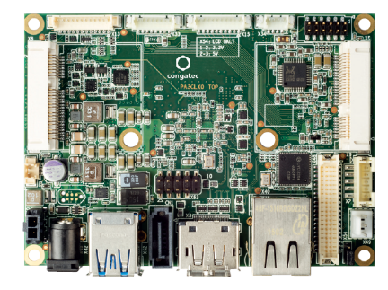
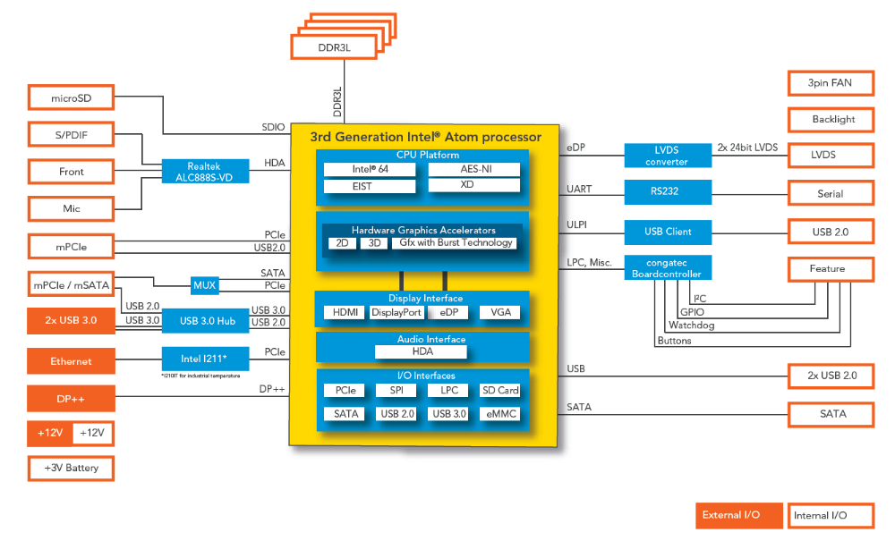
x86-64 solution (Atom quad core)

Slide 5
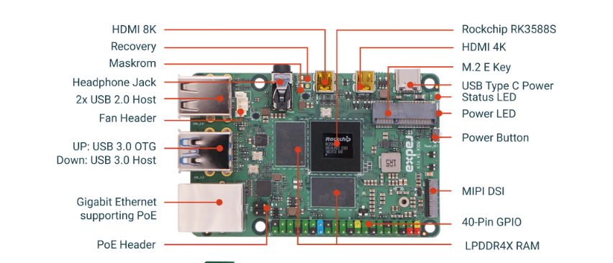
ARM v8 solution : RK5388
(ARM cores, GPU, NPU)

Slide 6
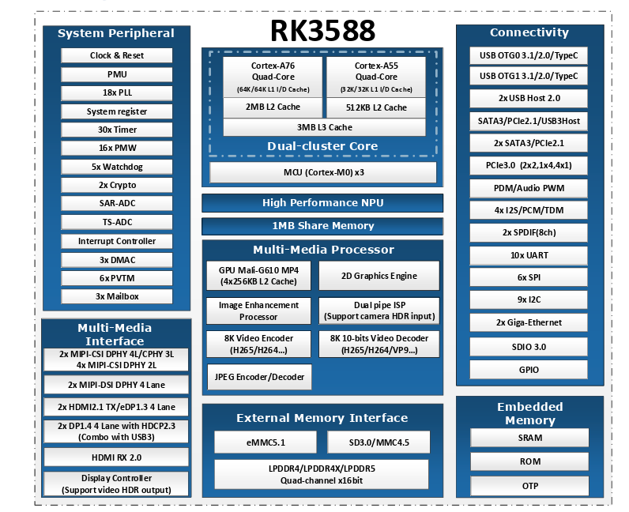
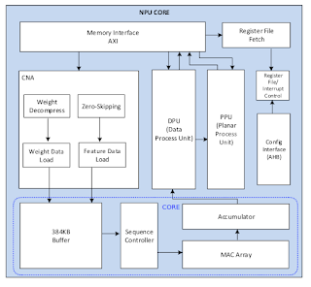

RK3588 internals

Slide 7
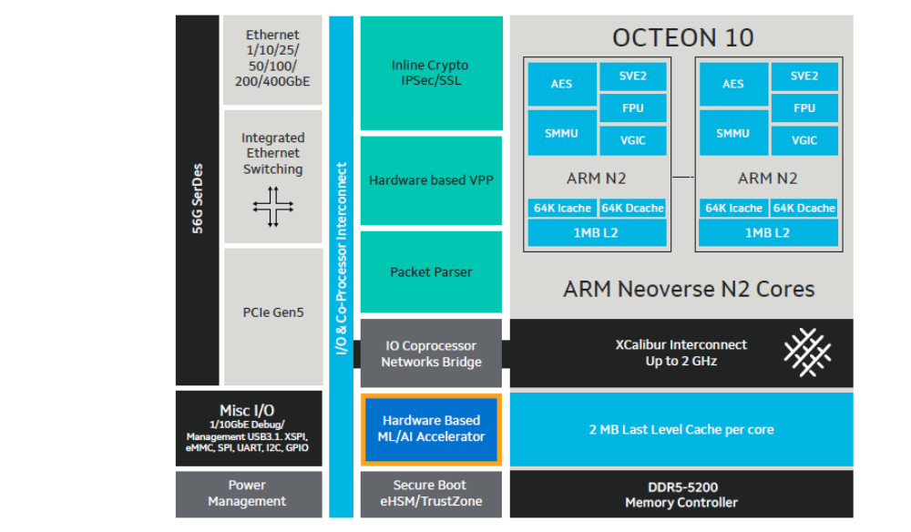
Recent Data Processing Unit (Marvell OCTEON DPU)

Slide 8
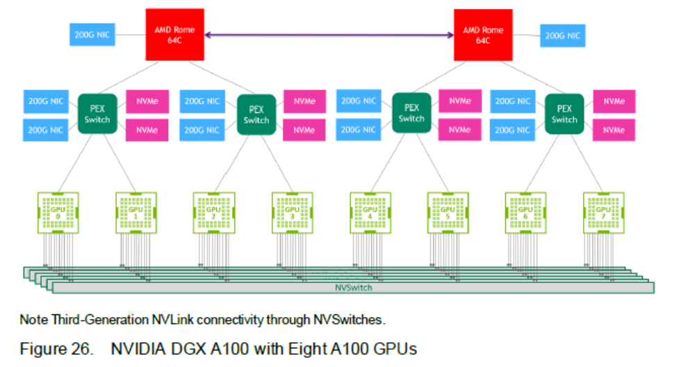
GPU-based HPC (original A100 DGX)

Slide 9
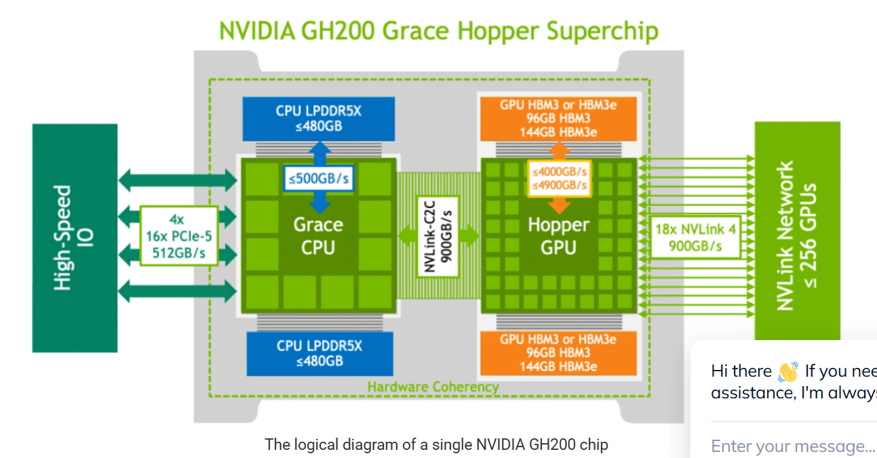
Nvidia GraceHopper GH200

Slide 10
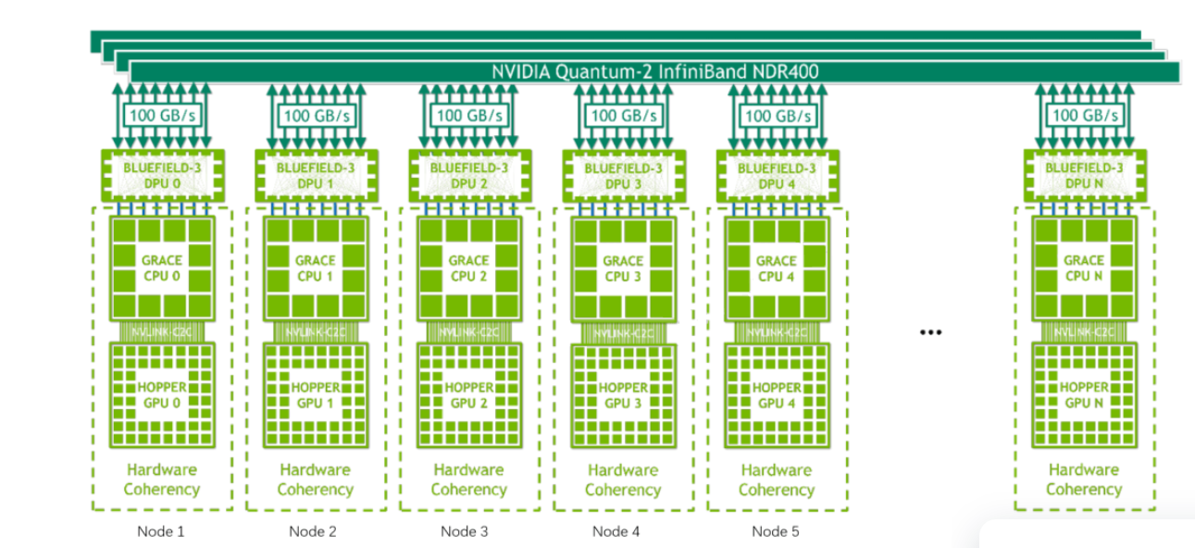
GH200 NVL system (e.g. NVL72)

Slide 11
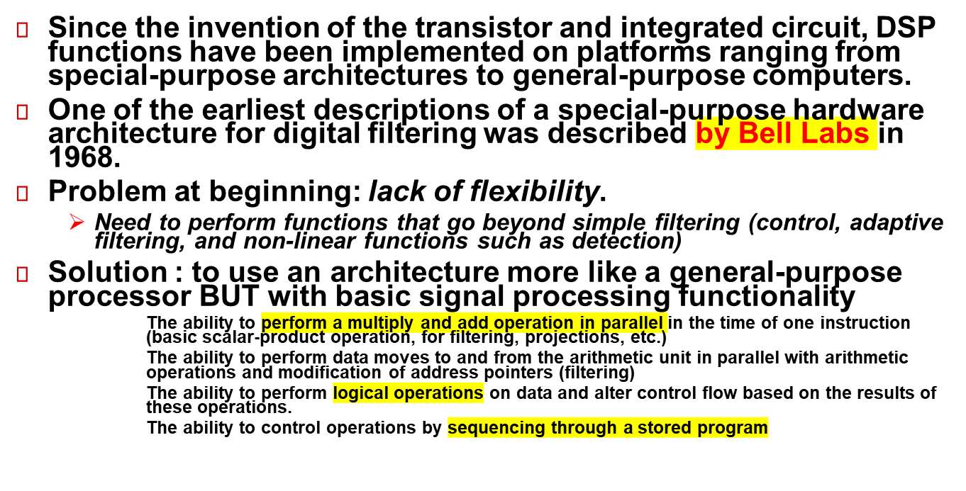
History

Slide 12
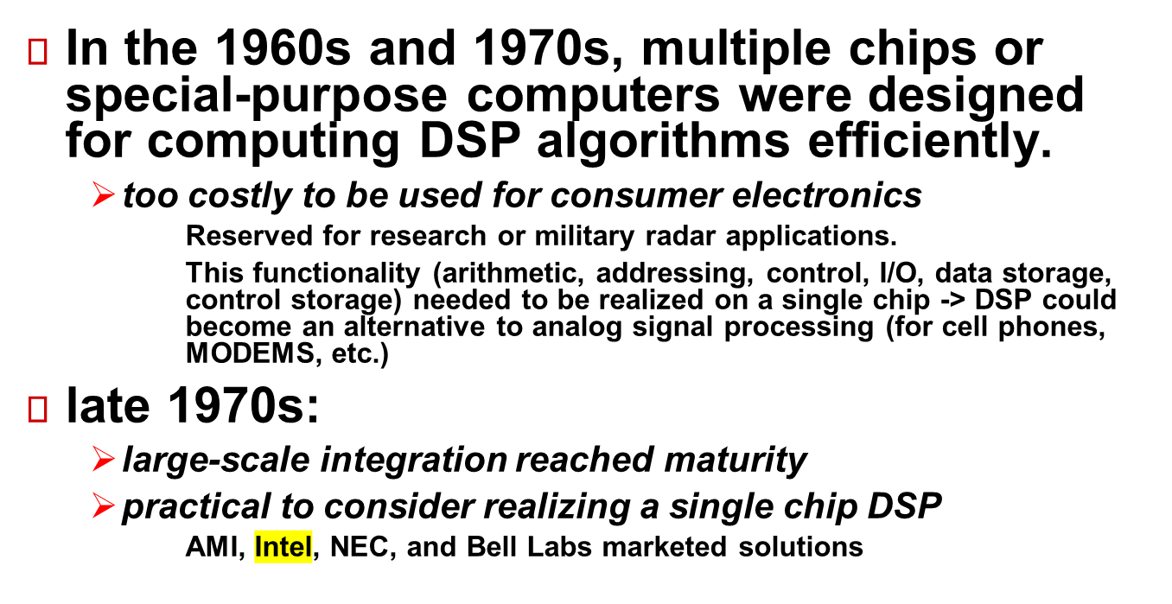
History (2)

Slide 13
First Generation DSP
AMI S2811 (1978)
  "Signal Processing Peripheral" in 1978.[1] was designed to operate in conjunction with a microprocessor such as the 6800 and depended upon it for initialization and configuration.[2] With a small, nonexpandable program memory of only 256 words, the S2811 was intended to be used to offload some math intensive subroutines from the microprocessor. Therefore, as a peripheral, it could not "stand alone" as could DSPs from Bell Labs, NEC, and other companies. The part was to be implemented in an exotic process technology called "V-groove." Availability of first silicon was after 1979 and was never used in any volume product.[3]
Intel 2920 (1979)
  "Analog Signal Processor" : on-chip analog/digital and digital/analog converter capability (like today’s wireless ASICs.)
  Drawback: lack of a multiplier (needed to be done by a series of instructions, shifting/adding) , limited to direct addressing, no branching.
  a little more efficient than a general-purpose microprocessor -> sacrificed flexibility, has little resemblance to today's single-chip DSP. Too slow for any complete application, it was used as a component for part of a modem.
NECµPD7720 (1980)
  “Digital signal processor” all of the attributes of a modern single chip DSP.
  devices and tools not available (in U.S.) until 1981.
The Bell Labs DSP1 (1979)
  key component in AT&T's first digital switch, 5ESS­, and many other telecommunications products
  devices with this architecture are still in manufacture today!
  contained all of the functional elements found in today's DSPs
    multiplier-accumulator (MAC), parallel addressing unit, control, control memory, data memory, I/O

Slide 14
Comparative Table
Date | Features | Example processors
First generation : 1979 - 1985 | Harvard architecture, hardwired multiplier | NECµPD7720, Intel 2920, Bell Labs DSP1, Texas Instruments TMS320C10
Second generation: 1985 - 1988 | Concurrency, multiple busses, on-chip memory | TMS320C25, MC56001, DSP16 (AT&T)
Third generation: 1988 - 1992 | On-chip floating point operations | TMS320C30, MC96002, DSP32C (AT&T),
Fourth generation: 1992 - 1997 | Multi-processing features Image and video processors Low-power DSPs (AT&T) | TMS320C40&50 TMS320C80
Fifth generation: 1997 – | VLIW,SIMD | TMS320C6x, Philips TriMedia, Motorola/Lucent Starcore, XScale (SIMD version)

Slide 15
Typical Compute applications
Different Computing Architectures are used/tailored for varieties of applications
  military radar systems to consumer electronics.
  no one processor can meet the needs of all applications.
  Criteria: performance, cost, integration, ease of development, power consumptions are key points to examine when designing or selecting a particular computing architecture for a class of applications.

Slide 16
FIR Filtering example
basic DSP operations:
  additions and multiplications
  delays
  array handling to access coefficients
Each has its own special set of requirements:
additions and multiplications require
  fetch two operands
  perform the addition or multiplication (usually both)
  store the result or hold it for a repetition
delays require
  hold a value for later use
array handling requires
  fetch values from consecutive memory locations
  copy data from memory to memory
To suit these fundamental operations DSP processors often have:
  parallel multiply and add (MAC operation)
  multiple memory accesses (to fetch two operands and store the result)
  lots of registers to hold intermediate results
  efficient address generation for array handling
  special features such as delays or circular addressing

Slide 17
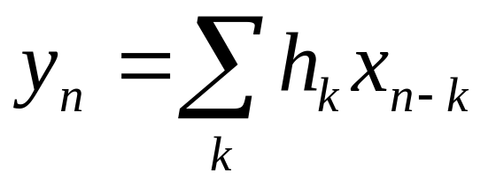
FIR Filtering (canonical example)
basic DSP operations:
  additions and multiplications
  delays
  array handling to access coefficients
Each has its own special set of requirements:
  additions and multiplications require
    fetch two operands
    perform the addition or multiplication (usually both)
    store the result or hold it for a repetition
  delays require
    hold a value for later use
  array handling requires
    fetch values from consecutive memory locations
    copy data from memory to memory
To suit these fundamental operations DSP processors often have:
  parallel multiply and add (MAC operation)
  multiple memory accesses (to fetch two operands and store the result)
  lots of registers to hold intermediate results
  efficient address generation for array handling
  special features such as delays or circular addressing

Slide 18
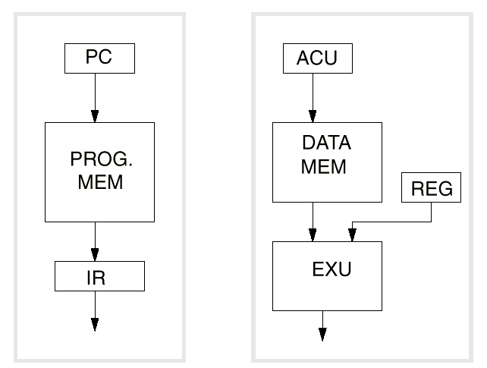
Harvard Architecture
Von Neumann architecture: Same address+data lines for instruction and data. Bad for DSP – better if MAC instruction executes in one cycle
Harvard Architecture: 4 buses - 2 address, 2 data

Slide 19
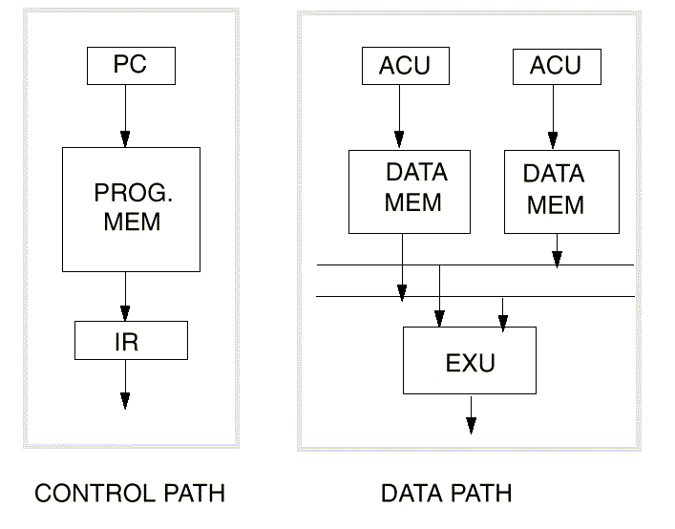
Modified Harvard Architecture
Two data memory accesses per cycle (for MAC!)
  Three memory banks, 1 program 2 data

Slide 20
Data Path
Where dominant arithmetic operations are performed
  DSP processor data paths are highly specialized to achieve high performance - multiply-accumulate operations. Registers, Adders, Multipliers, Comparators, Logic operators, Multiplexers, Buffers represent 95% of a typical DSP data path.
Multiplier
  single-cycle multiplier required. Important distinction between multipliers in DSPs is the size of the product according to the size of the operands. In general, multiplying two n-bit fixed-point numbers requires a 2xn bits to represent the correct result. For this reason DSPs have in general a multiplier, which is twice the word length of the native operands.
Accumulator Registers
  Accumulators registers hold intermediate and final results of multiply-accumulate and other arithmetic operations. Most DSP processors have two or more accumulators. In general, the size of the accumulator is larger than the size of the result of a product. These additional bits are called guard bits. These bits allow accumulating values without the risk of overflow and without rescaling. N additional bits allow up to 2^{N} accumulations to be performed without overflow. Guards bits method is more advantageous than scaling the multiplier product since it allows the maximum precision to be retained in intermediate steps of computations and does not require scaling at intermediate steps which would incur a performance loss.
ALU
  Arithmetic logic units implement basic arithmetic and logical operations. Operations such as addition, subtraction, and, or are performed in the ALU.
Shifter
  In fixed-point arithmetic, multiplications and accumulations often induce a growth in the bit width of results. Scaling is then necessary to pass results from stage to stage and is performed through the use of shifters.

Slide 21
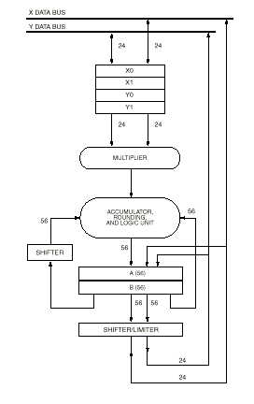
Datapath example (MC56002)

Slide 22
Addressing
ability to generate new addresses efficiently is a characteristic feature of DSP processors.
  Most DSP processors include one or more special address generation units (AGUs)
  AGU can perform one or more special address generation per instruction cycle without using the processor main data path.
  address calculation takes place in parallel with arithmetic operations on data, improving processor performance.
register-indirect addressing
  Data addressed is in memory and the address of the memory location containing the data is held in a register
  natural way to work with arrays of data (e.g. filter coefs)
  efficiency from an instruction-set point of view -> allows powerful and flexible addressing with few bits in the instruction word.
  When operand is fetched from memory, address register can be incremented to point to the next needed value in the array.

Slide 23
Typical Increment formats
*rP | Register indirect | read the data pointed to by the address in register rP
*rP++ | Postincrement | read the data pointed to by the address in register rP Having read the data, postincrement the address pointer to point to the next value in the array
*rP-- | Postdecrement | Having read the data, postdecrement the address pointer to point to the previous value in the array
*rP++rI | Register postincrement | Having read the data, postincrement the address pointer by the amount held in register rI to point to rI values further down the array
*rP--rIr | Bit reversed (FFT) | having read the data, postincrement the address pointer to point to the next value in the array, as if the address bits were in bit reversed order

Slide 24
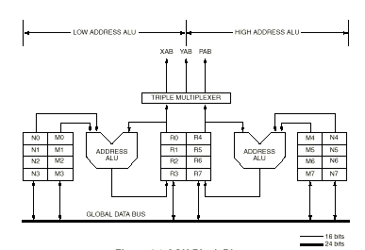
Addressing (2)
Ex: MC56002
Modulo-N/circular addressing
  Circular access of a memory buffer (x[BASEADR + i%N])
  Instead of comparing an address counter to a calculated value to see whether or not the end of the buffer has been reached, dedicated registers are used to automatically perform this check

Slide 25
Peripherals
Most DSP processors have on-chip peripherals and interfaces to allow the DSP to be used in an embedded system -> minimize external hardware to support its operation and interfacing (to converters, busses, fifos, other DSPs in multiprocessor systems, etc.)
Serial port
  A serial interface transmits and receives data one bit at a time. These ports have a variety of applications like sending and receiving data samples to and from A/D and D/A converters and codecs, sending and receiving data to and from other microprocessors or DSPs, communicating with other hardware.
Host Port
  Some DSPs provide a host port for connection to a general-purpose processor or another DSP. Host ports are usually specialized 8 or 16 bit bi-directional parallel ports that can be used to transfer data between the DSP and the host processor.
  Ex: (TMS320C6x : configurable 32-bit port can even implement PCI protocol, useful in high-end systems, e.g. basestations, DSLAMs, etc)
Link ports or communication ports
  This kind of port is dedicated to multiprocessor operations. It is in general a parallel port intended for communication between the same types of DSPs.

Slide 26
Peripherals (2)
Interrupt controller
  An interrupt is an external event that causes the processor to stop executing its current program and branch to a special block of code called an interrupt service routine. Typically this code deals with the origin of the interrupt and then returns from the interrupt. There are different interrupt sources:
  On-chip peripherals generate interrupts: serial ports, timers, DMA,…
  External interrupt lines: dedicated pins on the chip to be asserted by external circuitry (synchronization events)
  Software interrupts: also called exceptions or traps, these interrupts are generated under software control or occurs for example for floating-point exceptions (division-by-zero, overflow and so on).
  DSPs associate interrupts with different memory locations. These locations are called interrupt vectors. These vectors contain the address of the interrupt routines. When an interrupt occurs, the following scenario is often encountered:
    Save program counter in a stack
    Branch to the relevant address given by the interrupt vector table
    Save all registers used in the interrupt routine
    Perform dedicated operations
    Restore all registers
    Restore program counter
  Priority levels can be assigned to the different interrupt through the use of dedicated registers. An interrupt is acknowledged when its priority level is strictly higher that current priority level.

Slide 27
Timers
  Programmable timers are often used as a source of periodic interrupts. Completely software-controlled to activate specific tasks at chosen times. It is generally a counter that is preloaded with a desired value and decremented on clock cycles. When zero is reached, an interrupt is issued.
  Used to sequence events (real-time processing), like perform a filtering operation periodically with a period depending on the input event
  Allows for partitioning of DSP between different processing threads
DMA – Direct Memory Access
  technique whereby data can be transferred to or from the processor’s memory without the involvement of the processor itself. DMA is commonly used to provide improved performance with input/output devices.
  software loads the DMA controller
    the starting address for the transfer
    the number of words to be transferred
    the source and the destination.
  Once obtaining bus-mastership, the DMA controller performs the transfer and optionally signals completion through an interrupt.
  Some processors have multiple DMA channels

Slide 28
Superscalar Architectures
The key to higher performance in microprocessors for a broad range of applications is the ability to exploit fine-grain, instruction-level parallelism. Some methods for exploiting fine-grain parallelism include:
  pipelining
  multiple processors
  superscalar implementation
  specifying multiple independent operations per instruction

Slide 29
Superscalar Architectures
Pipelining is now universally implemented in high-performance processors. Little more can be gained by improving the implementation of a single pipeline.
Using multiple processors improves performance for only applications designed to do so.
Superscalar implementations can improve performance for all types of applications. Superscalar (super:beyond; scalar: one dimensional) means the ability to fetch, issue to execution units, and complete more than one instruction at a time.
Superscalar implementations are required when architectural compatibility must be preserved, and they will be used for entrenched architectures with legacy software, such as the x86 architecture that dominates the PC market.

Slide 30
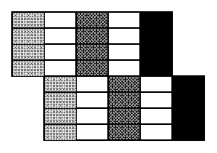
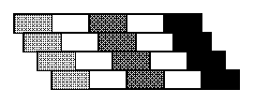
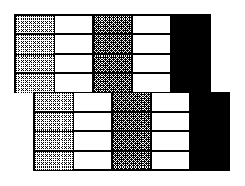
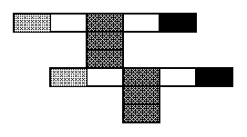
Superscaler alternatives
Superpipelined
Superscaler
VLIW
Superscaler/Superpipelined

Slide 31
VLIW – Very Long Instruction Word
Specifying multiple operations per instruction creates a very-long instruction word architecture or VLIW. A VLIW implementation has capabilities very similar to those of a superscalar processor—issuing and completing more than one operation at a time
  exception: the VLIW hardware is not responsible for discovering opportunities to execute multiple operations concurrently. For the VLIW implementation, the long instruction word already encodes the concurrent operations. This explicit encoding leads to dramatically reduced hardware complexity compared to a high-degree superscalar implementation of a RISC or CISC.
The big advantage of VLIW, then, is that a highly concurrent (parallel) implementation is much simpler and cheaper to build than equivalently concurrent RISC or CISC chips. VLIW is a simpler way to build a superscalar microprocessor.
  Reason for its popularity in high-end DSPs (TI C6x,FreeScale StarCore, TriMedia)

Slide 32
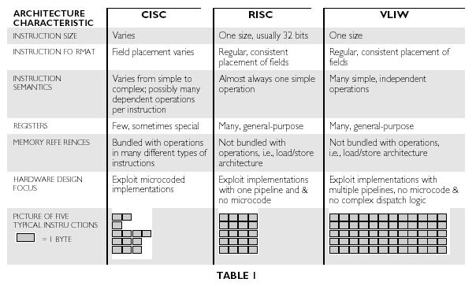

Slide 33
Hardware vs. Software Parallelism
From the point of view of the programmer the primary difference is that in Superscaler RISC/CISC (Pentium, PowerPC, Sparc, etc.) processors, parallelism is guaranteed by the processors hardware
  So, parallelism is transparent to the programmer, who has to live with the choices
  Results in complex circuits
In VLIW, parallelism is up to the programmer (i.e. compiler)
  Requires either tricky programming (in assembler) to achieve optimality or a very good compiler (a problem too) to achieve optimal performance
  Putting the optimization in the software reduces the time to market.

Slide 34
Hardware vs. Software Parallelism
HW/SW trade-off has a significant side benefit: the complexity is paid for only once, when the compiler is written instead of every time a chip is fabricated.
Benefits:
  smaller chip, which leads to increased profits for the microprocessor vendor and/or cheaper prices for the customers that use the microprocessors.
Complexity is usually easier to deal with in a software design than in a hardware design. Thus, the chip may cost less to design, be quicker to design, and may require less debugging, all of which are factors that can make the design cheaper.
Improvements to the compiler can be made after chips have been fabricated!

Slide 35
Practical VLIW
The simplest VLIW instruction format encodes an operation for every execution unit in the machine. This makes sense under the assumption that every instruction will always have something useful for every execution unit to do.
it is typically not possible to pack every instruction with work for all execution units. Also, in a VLIW machine that has both integer and floating-point execution units, the best compiler would not be able to keep the floating-point units busy during the execution of an integer-only application.
VLIW has had large practical impact on DSP systems (why?)

Slide 36
Problems and optimizations with VLIW
The problem with instructions that do not make full use of all execution units is that they waste precious processor resources: instruction memory space, instruction cache space, and bus bandwidth.
There are at least two solutions to reducing the waste of resources due to sparse instructions. First
  instructions can be compressed (e.g. source coding!) to allocate the fewest bits to the most frequently used operations.
Second, it is possible to define an instruction word that encodes fewer operations than the number of available execution units.
  Imagine a VLIW machine with ten execution units but an instruction word that can describe only five operations. In this scheme, a unit number is encoded along with the operation; the unit number specifies to which execution unit the operation should be sent.
  The benefit is better utilization of resources. A potential problem is that the shorter instruction prohibits the machine from issuing the maximum possible number of operations at any one time. To prevent this problem from limiting performance, the size of the instruction word can be tuned based on analysis of simulations of program behavior.
Of course, it is completely reasonable to combine these two techniques: use compression on shorter-than maximum-length instructions.

Slide 37
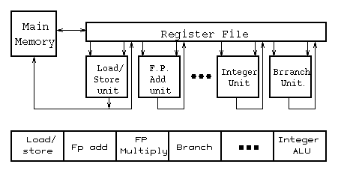
VLIW Processor and Instruction Format

Slide 38
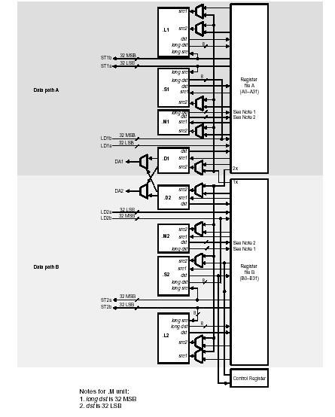
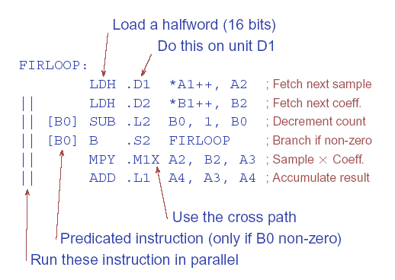
C6x Datapaths and Example instruction (FIR Filter)

Slide 39
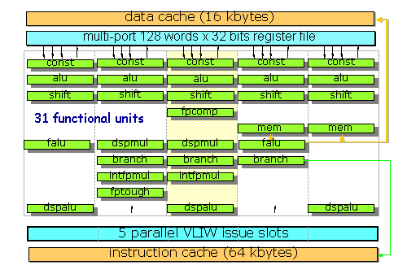
TriMedia Core Organization
31 Functional Units
5-way parallelism
Some are SIMD!
Popular processor for imaging

Slide 40
Single-Instruction Multiple-Data (SIMD)
SIMD provides vector processing instructions to both CISC/RISC architectures and VLIW
  CISC Examples: Pentium 2/3/4 (MultiMedia eXtensions –MMX, SSE/SSE2/SSSE3/SSE4/AVX/AVX2/AVX512)
  RISC Examples: UltraSparc (VIS), PowerPC (AltiVec), XScale (Wireless MMX), ARM (NEON)
  VLIW/SIMD Examples: TI C64, TriMedia, Itanium/Itanium2, StarCore, Hexagon
Targets audio/image processing (for PCs and PDAs/Smartphones) and signal processing in general (for DSPs)

Slide 41
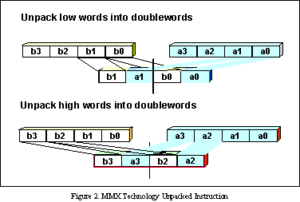
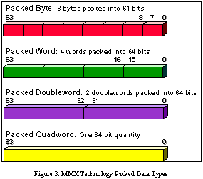
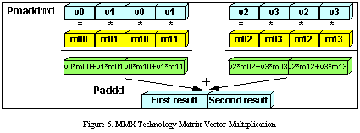
Classical MMX Example

Slide 42
Important programming issues
SIMD can be a powerful technique for DSP if coding is done properly
  Most operations can be vectorized
    FIR filtering is essentially sliding-window inner-products
    Viterbi Algorithm can be easily vectorized by grouping state transitions
    Complex multiply is 1 SIMD MAC -> FFT!
Memory-alignment is an issue for filters

Slide 43
DSP on FPGAs
An FPGA is a reconfigurable circuit made up of memory, logic and switching fabric and a simple interconnection network
It was traditionally a prototyping technology for ASICs since efficiency (power, size) is sacrificed to provide for reconfigurability
It is commonly used for high-end DSP and networking applications (basestations, DSLAMs, specialized routers, etc.)
It is possible to design custom SoC architectures (processor, co-processors + OS) on modern FPGAs

Slide 44
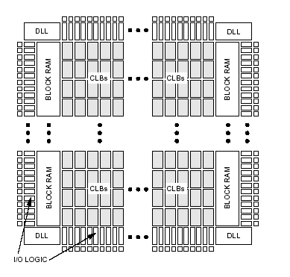
Typical FPGA Floorplan
FPGA contains
  Block RAM
  Computational Logic Blocks (CLBs)
  Frequency synthesizers (DLLs)
  I/O Pads+Logic
  DSP functions (Multipliers)

Slide 45
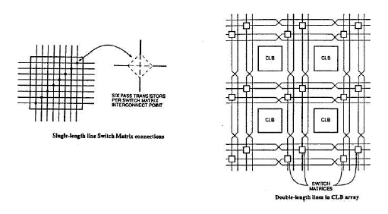
Typical FPGA Routing
Routing

Slide 46
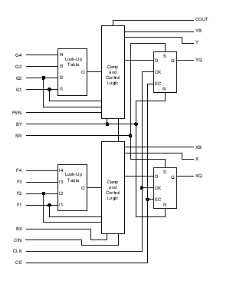
Typical CLB
CLB contains
  2 Look-up-tables (LUTs) 4x1
  2 Carry/control logic blocks
  2 Flip-flops

Slide 47
Building Complex DSP Systems on FPGAs
DSP systems can be standalone on an FPGA
  Front-end signal processing in a basestation
    Filtering, channelization, up/down conversion
A more complete solution (baseband MODEM) can benefit from software control and mini-OS via
  Hardcore embedded processors (e.g. ARM)
  Softcore embedded processor using FPGA resources (MicroBlaze-Xilinx, NIOS-Altera, LEON 3-generic)
  Busses and peripherals on FPGA fabric
    Xilinx – IBM CoreConnect (PLB/OBP Bus) => ARM Cortex + AMBA/AXI (partially on FPGA fabric)
    Altera – Avalon, AMBA
    Leon 3 - AMBA
    RISC-V
DSP circuits can then be tailored to the application at hand either as
  Co-processors on processor busses (local or peripheral)
  Extensions to instruction set (e.g. with PowerPC/LEON)

Slide 48
Rich IP library
Many FPGA vendors give away IP blocks to encourage use of their technology
  Modulators/Demodulators
  FFTs,DCTs
  Reconfigurable Filters
  Channel encoder/decoders
See web for examples

Slide 49
This time …
Superscalar and Parallel architectures
  SIMD, VLIW
DSP on FPGAs

